Slide 1
LP III-Group C
Ms. Manjusha Tatiya

Slide 2
Assignment 3

Slide 3
Writing a Smart contract in Remix IDE
Remix-IDE - a powerful open-source tool that provides the ability to develop a smart contract from a browser.
pragma solidity ^0.6.6;contract BankContract { struct client_account{ int client_id; address client_address; uint client_balance_in_ether; } client_account[] clients; }

Slide 4
to assign an ID to each client whenever they join the contract, so we define an int counter and set it to 0 in the constructor of the contract.
pragma solidity ^0.6.6;contract BankContract { struct client_account{ int client_id; address client_address; uint client_balance_in_ether; } client_account[] clients; int clientCounter; constructor() public{ clientCounter = 0; } }

Slide 5
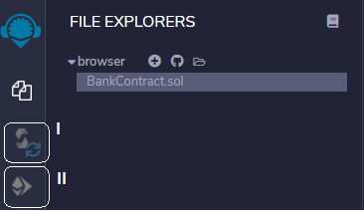
The Final State of the Smart Contract
Click for the code: smart_contract.docx
Compile the Smart Contract
After finishing the development of the smart contract, we’ll compile it onto the Remix IDE.

Slide 6
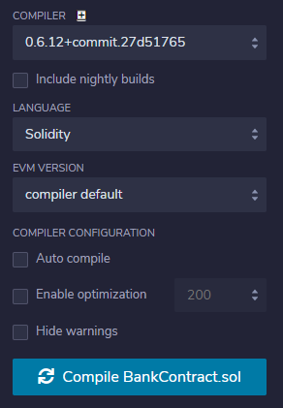
The following image shows what we face when we go to the Solidity Compiler section. We select the compiler version according to the version we specified before and click the button at the bottom of the section.

Slide 7
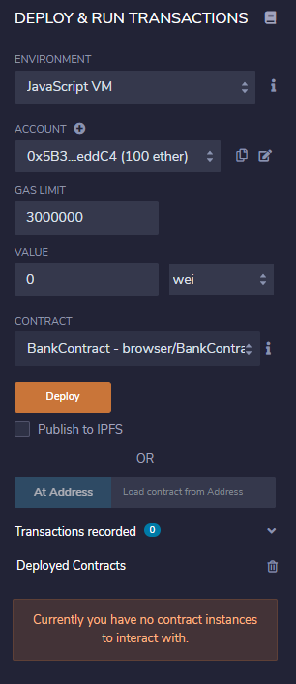
Deploy the Smart Contract
The Remix IDE presents various opportunities to deploy the smart contract into various environments.

Slide 8
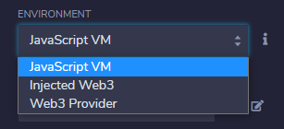
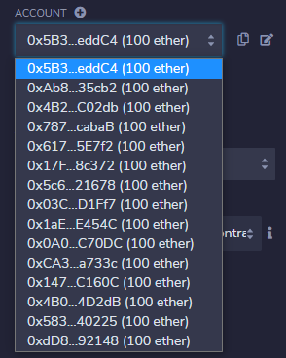
In the accounts combo, there are many accounts we’ll be able to use during the deploying and testing of the smart contract. Among these accounts that the Remix IDE
deploy our contract on the JavaScript VM environment, so we’ll select it among the following environments.

Slide 9
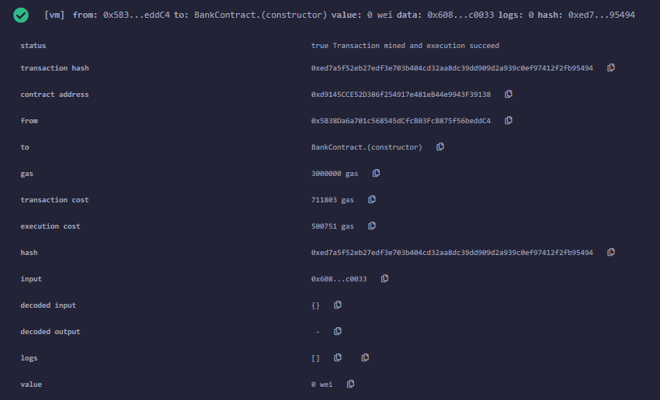
After setting the environment and the account, we’re ready to deploy it, so we click the Deploy button.

Slide 10
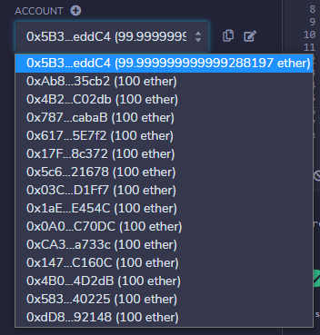
According to the result of the transaction above, the smart contract was deployed to the account selected successfully.
Deploying the smart-contract operation causes a cost to the sender who deploys it.
The transaction cost represents the cost we need to deploy the contract — the amount placed in the transaction cost was taken from the account — as shown in the following image.

Slide 11

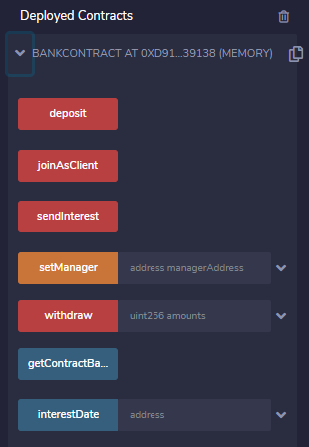
The smart contract deployed can be seen in the Deployed Contracts subsection on the left.
Run the Transactions
call the functions that compound the smart contract developed. When we expand the relevant contract in the Deployed Contract subsection, the methods developed appear.

Slide 12
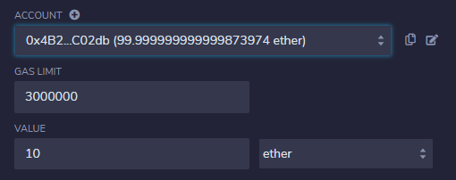
The deposit method
Now, we’ll send 10 ETH from the clients’ accounts to the contract by using the deposit method. In the deposit method, we take the amount declared in the msg.value from the sender that’s represented in the msg.sender variable.
we set 10 ETH and call the deposit method by clicking the red deposit button for each client account
, like we did before for the joinAsClient method. After these operations, the following messages show in the terminal,
which means those three accounts sent 10 ETH from their account to the contract address.
Also, the final state of the accounts’ balances look like this:

Slide 13
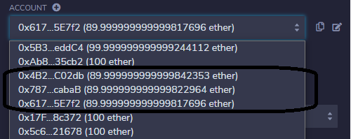
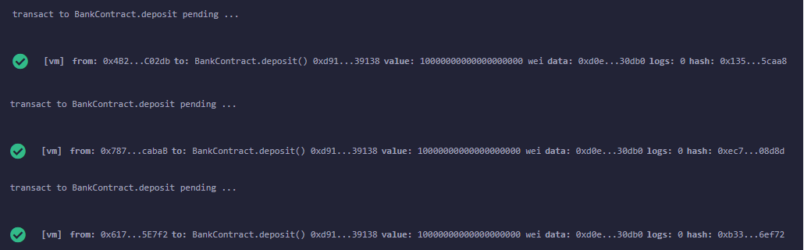

Slide 14
Reference

Slide 15
Thank You!!!

